Slide 1
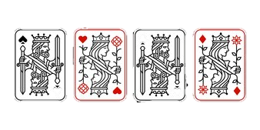
INDIVIDUAL PROJECT PRESENTATION
CS310S: FOUNDATIONS OF OBJECT-ORIENTED SOFTWARE DEVELOPMENT.
ASSIGNMENT BY: ASIF MOHAMMAD TANVIR
ID: 230340086

Slide 2
Introduction
It is a Python-based assignment to create a single-player text-based game.
I opted to develop a card game named "BLACKJACK.”
In these slides, I will present a comprehensive guide to object-oriented software development for the game of Blackjack.
Content:
1. Introduction
2. What is the BlackJack ?
3. How the Game Played?
4. The BlackJack Game Code.
5. Classes and object-oriented design.
6. UML design with three class along with explanation of code.
7. Flowchart of UML
8. Black Box Testing
9.How can I tweak the game.

Slide 3
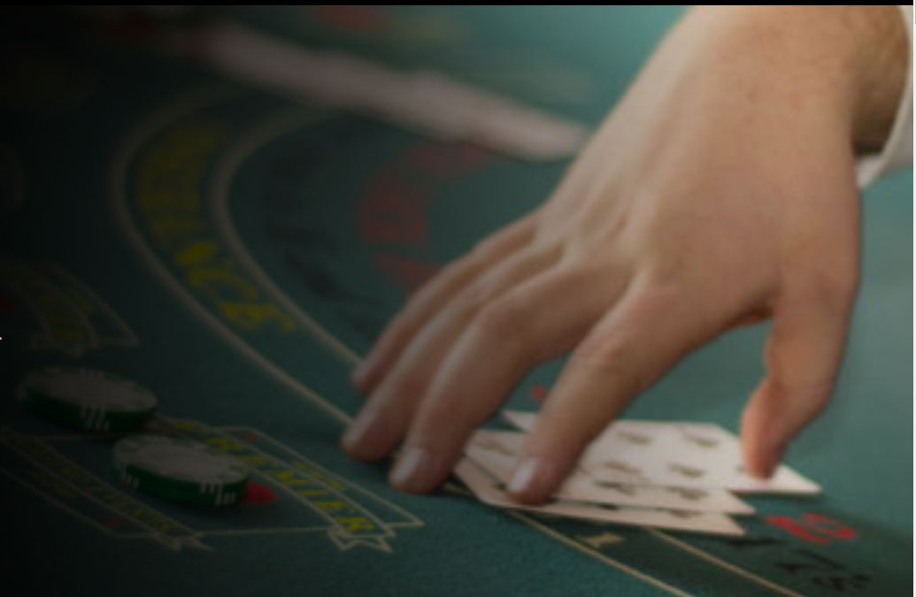
What is the BlackJack Game?
It is a card game where the objective is to reach a specific total of 21.
In some places, it is called 21 Card Game.
Playing the game is thrilling, with simple rules and opportunities for high strategy. It's a mindful game.
Its played dealer vs player. It can be played in 2/3/4 or more formations.

Slide 4
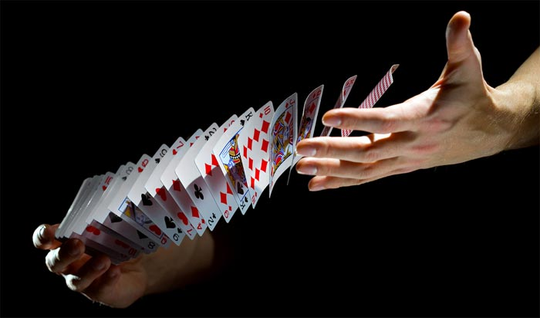
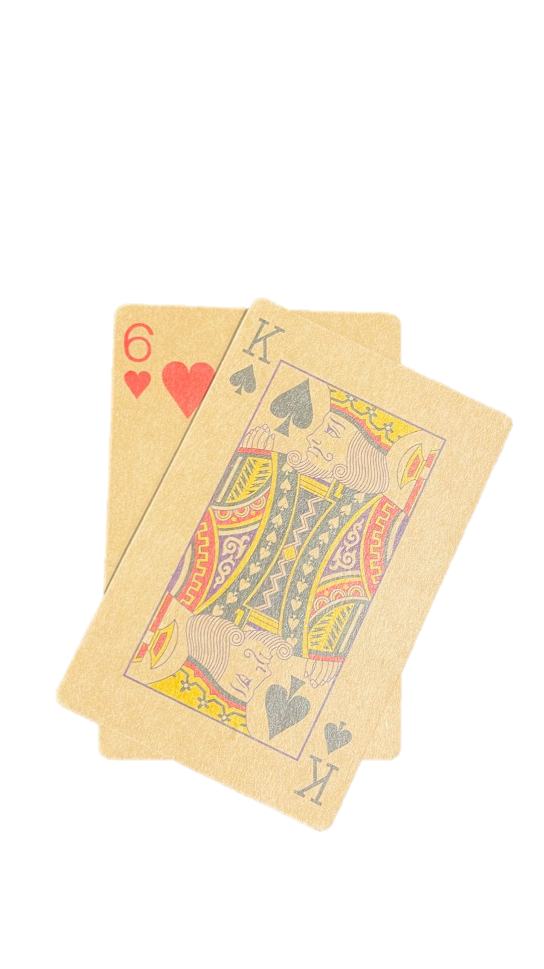
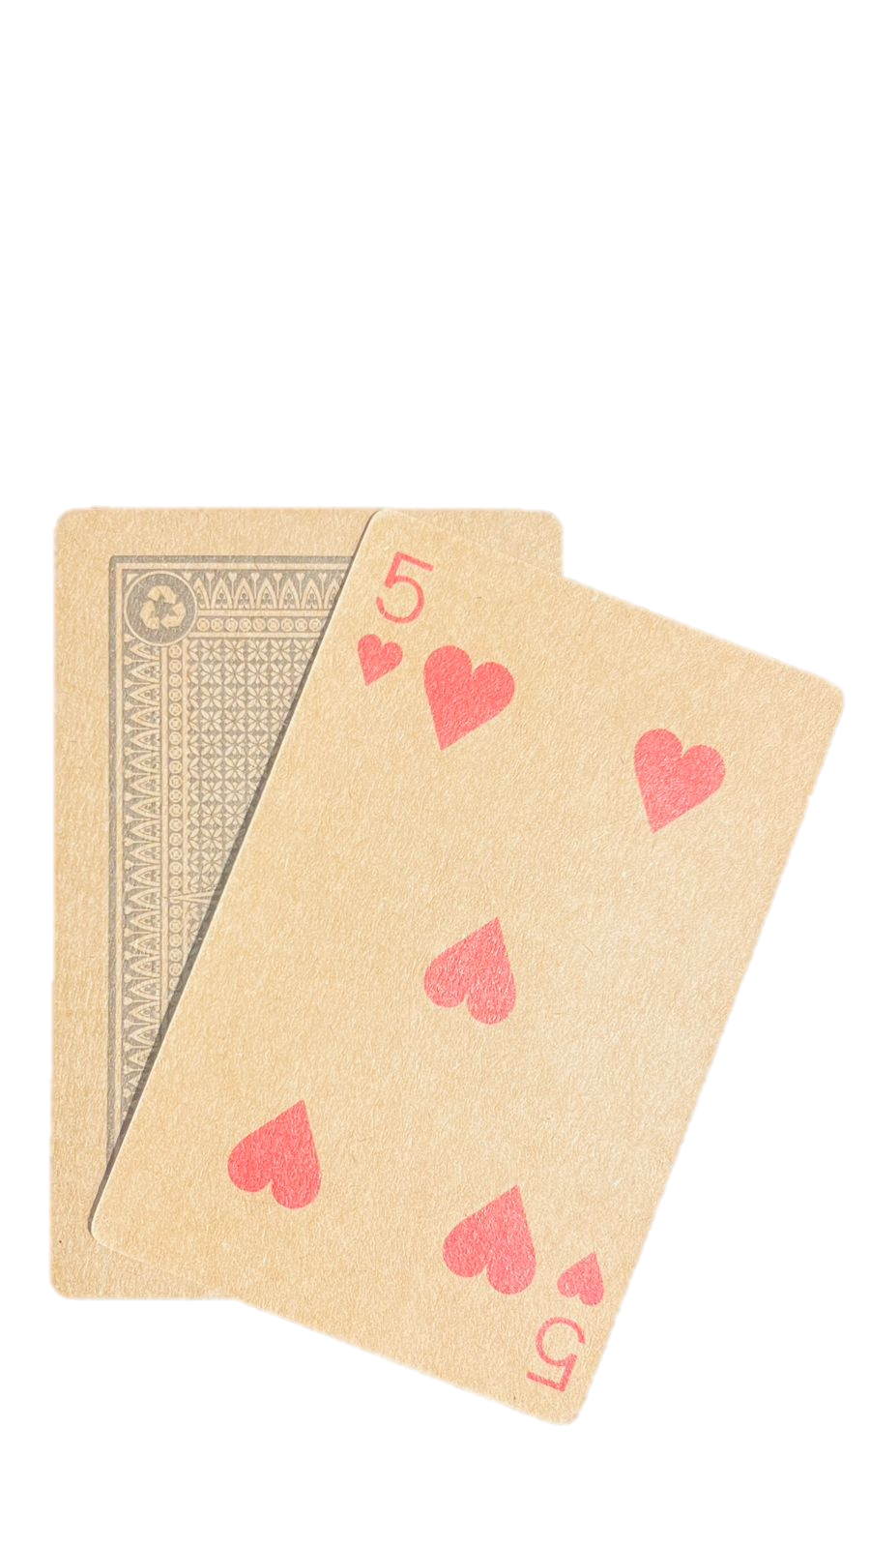
How the game played?
At the start of the game, the dealer will shuffle a deck of 52 cards until players are satisfied.
The dealer will give two cards to the player and himself. The player’s card will be face up, while the dealer’s cards will be one face up and one face down.
Players Hand
Dealers Hand

Slide 5

How the game played?
In a real scenario, a bet would be placed, but my game does not use bets.
Based on the players imagination and strategies player will choose ‘ Hit’ or ‘Stand’.
Where hit means ‘Give more cards one by one’
Stand means ‘ Give no Cards’
‘HIT’ or ‘STAND’

Slide 6
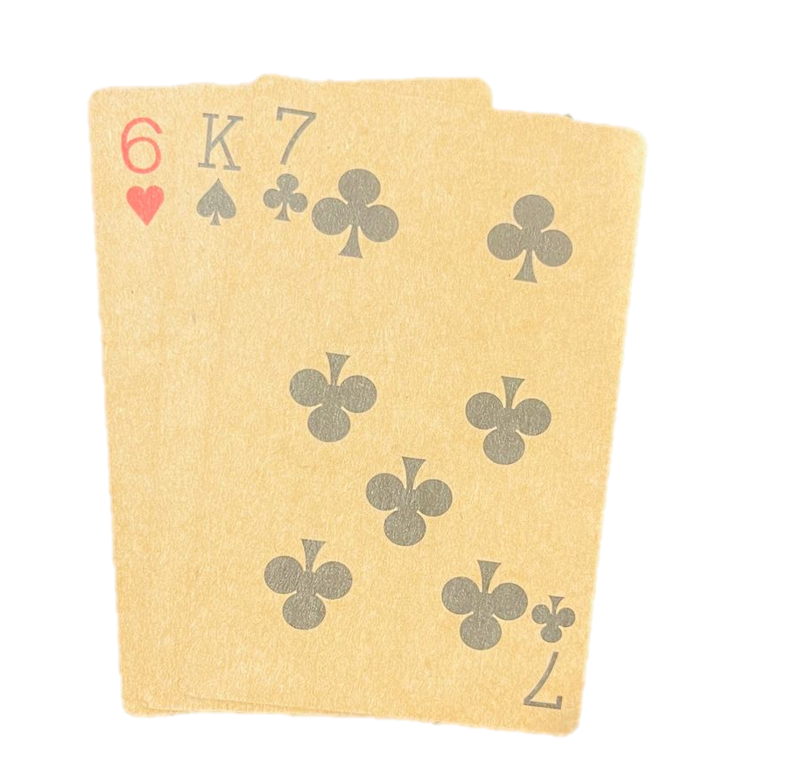
How the game played?
If player choose HIT then player will get one more card.
Player hand.
The goal of the game is to get a score closer to 21 than the dealer's score. If the player's score is greater than the dealer's, then the player wins. Conversely, if the dealer's score is greater than the player's, the dealer wins. If both scores are the same and under 21, then it's a tie and the bet is returned to the player. However, if both the player's and the dealer's scores exceed 21, then the game is dismissed.
Jackpot!!!! Player wins!!!

Slide 7
1
The BlackJack Game Code:
import random #importing random module class BlackJackCard: #class of Card def __init__(b,cardsuit,cardrank): #using b instead of self. #c resembles card,b resembles blackjack game or self b.csuit=cardsuit b.crank=cardrank def __str__(b): #magic/dunder method return (f'{b.crank} of {b.csuit}') #string representation of object before class BlackJackDeck: #deckLibrary def __init__(b): b.csuits=['Clubs','Spades','Hearts','diamonds'] b.cranks=['J','K','Q','A','2','3','4','5','6','7','8','9'] b.ccards=[BlackJackCard(csuit,crank) for csuit in b.csuits for crank in b.cranks] def BlackJackshuffle(b): random.shuffle(b.ccards) #random shuffle of all cards from deck def BlackJackdeal(b): return b.ccards.pop() #pop:will take from library and removes it.
Let's take a overall view of my code:
I will explain briefly in later slides

Slide 8
3
def show_hands(b,player_turn=False): #boolean print('Your Hand: ',[str(card) for card in b.user_hand], 'Score: ',b.Score(b.user_hand)) if player_turn: print("Computer's Hand: ",str(b.distributor_hand[0])) #will show the one card only #else: #print("Computer's Hand: ",str(b.distributor_hand[0]),"[Hidden]") def BlackJackplay(b): b.user_hand=[] b.distributor_hand=[] b.deal_first() while b.Score(b.user_hand)<21: b.show_hands(player_turn=True) action=input("Do you want to 'hit' or 'stand'?: ").lower() #action will take at lower letter if action=='hit': b.user_hand.append(b.bjdeck.BlackJackdeal()) if action == 'stand': break b.show_hands(player_turn=False) while b.Score(b.distributor_hand)<17: b.distributor_hand.append(b.bjdeck.BlackJackdeal()) user_score=b.Score(b.user_hand) distributor_score=b.Score(b.distributor_hand) #print
The BlackJack Game Code:
2
class BlackJackGame: def __init__(b): b.bjdeck = BlackJackDeck() #bj resembles blackjack b.bjdeck.BlackJackshuffle() b.user_hand=[] #player b.distributor_hand=[] #dealer def deal_first(b): for x in range(2): #for the first two cards b.user_hand.append(b.bjdeck.BlackJackdeal()) b.distributor_hand.append(b.bjdeck.BlackJackdeal()) def Score(b,hand): Total_number=0 If_aces=0 #4 Aces,starts with 0 for card in hand: if card.crank.isdigit(): Total_number += int(card.crank) elif card.crank in ['J', 'Q', 'K']: Total_number+=10 elif card.crank in ['A']: Total_number += 11 #'A' is either 11 or 1 depending the condition of the game If_aces += 1 while Total_number > 21 and If_aces: Total_number-=10 #maintaing 'A' as 1 If_aces-=1 #removing one card
return Total_number #returning only total number

Slide 9
The BlackJack Game Code:
4
print("Computer's Hand: ",[str(card) for card in b.distributor_hand], "Score: ",b.Score(b.distributor_hand)) if user_score > 21 or (distributor_score<=21 and distributor_score>user_score): print('Dealer Wins!!') elif user_score <= 21 and distributor_score<=21 and distributor_score==user_score: print('Push(Its a tie') #meeting every possibility,added this after 5-6 test. elif user_score >21 and distributor_score>21 and user_score==distributor_score: print('Game is Dismissed') #meeting every possibility,added this after 5-6 test. else: print('Player wins!!') if __name__== '__main__': #running as the main program. print('''Welcome to BlackJack. #Rule of Game: You have to get closer to 21 and Greater than your Dealer. #Rule in Game: You have to write in Keyboard 'hit' to continue run, 'stand' to display the hands. Enjoy the Game!!''') #a welcome note with rules. while True: game=BlackJackGame() game.BlackJackplay() game_again= input('Do you want to play again?(y/n): ').lower() #will take lower capital word if game_again != 'y': break #done

Slide 10
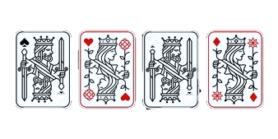
Classes and Object-Oriented Design:
Class BlackJackCard:
It is a class representing a single card in the main game that returns the card's string.
I have three classes here:
Class 1 : BlackJackCard
Class 2: BlackJackDeck
Class 3: BlackJackGame
Class BlackJackDeck:
Class deck represents the deck of cards used in a game, including Hearts, Diamonds, Clubs, and Spades. The deck includes cards numbered 2-10, as well as Jacks, Kings, Queens, and Aces. It includes dealing and shuffling
Class BlackJackGame:
It's the main class of the game and defines the game, containing a shuffled deck object and two empty hands - one for the player and one for the dealer. The gameplay includes dealing initial hands and a scoring method..

Slide 11
Explanation of Coding :
Importing the random module:
I am starting by importing the random module, which is used for shuffling the deck of cards later in the code.
import random #importing random module

Slide 12
UML design for three class along with explanation of Code:
BlackJackCard
-csuit: str -crank: str
+__init__(cardsuit:str, cardrank:str) +__str__(): str
class BlackJackCard: #class of Card def __init__(b,cardsuit,cardrank): #using b instead of self. #c resembles card,b resembles blackjack game or self b.csuit=cardsuit b.crank=cardrank def __str__(b): #magic/dunder method return (f'{b.crank} of {b.csuit}') #string representation of object before
UML diagram
Coding

Slide 13
UML design for three class along with explanation of Code:
BlackJackDeck
-csuits: list of str -cranks: list of str -ccards: list of BlackJackCard
+__init__() +BlackJackShuffle() +BlackJackDeal():ccard.pop()
class BlackJackDeck: #deckLibrary def __init__(b): b.csuits=['Clubs','Spades','Hearts','diamonds'] b.cranks=['J','K','Q','A','2','3','4','5','6','7','8','9'] b.ccards=[BlackJackCard(csuit,crank) for csuit in b.csuits for crank in b.cranks] def BlackJackshuffle(b): random.shuffle(b.ccards) #random shuffle of all cards from deck def BlackJackdeal(b): return b.ccards.pop() #pop:will take from library and removes it.
Coding
UML diagram

Slide 14
UML design for three class along with explanation of Code:
class BlackJackGame: def __init__(b): b.bjdeck = BlackJackDeck() #bj resembles blackjack b.bjdeck.BlackJackshuffle() b.user_hand=[] #player b.distributor_hand=[] #dealer def deal_first(b): for x in range(2): #for the first two cards b.user_hand.append(b.bjdeck.BlackJackdeal()) b.distributor_hand.append(b.bjdeck.BlackJackdeal()) def Score(b,hand): Total_number=0 If_aces=0 #4 Aces,starts with 0 for card in hand: if card.crank.isdigit(): Total_number += int(card.crank) elif card.crank in ['J', 'Q', 'K']: Total_number+=10 elif card.crank in ['A']: Total_number += 11 #'A' is either 11 or 1 depending the condition of the game If_aces += 1 while Total_number > 21 and If_aces: Total_number-=10 #maintaing 'A' as 1 If_aces-=1 #removing one card return Total_number #returning only total number def show_hands(b,player_turn=False): #boolean print('Your Hand: ',[str(card) for card in b.user_hand], 'Score: ',b.Score(b.user_hand)) if player_turn: print("Computer's Hand: ",str(b.distributor_hand[0])) #will show the one card only #else: #print("Computer's Hand: ",str(b.distributor_hand[0]),"[Hidden]")
BlackJackGame
-bjdeck: BlackJackDeck () -user_hand: List of cards for player -distributor_hand: List of cards for dealer/computer.
+__init__() + deak_first() + Score () +show_hands(player turn=Boolean)
UML diagram
Coding

Slide 15
Coding
def BlackJackplay(b): b.user_hand=[] b.distributor_hand=[] b.deal_first() while b.Score(b.user_hand)<21: b.show_hands(player_turn=True) action=input("Do you want to 'hit' or 'stand'?: ").lower() #action will take at lower letter if action=='hit': b.user_hand.append(b.bjdeck.BlackJackdeal()) if action == 'stand': break b.show_hands(player_turn=False) while b.Score(b.distributor_hand)<17: b.distributor_hand.append(b.bjdeck.BlackJackdeal()) user_score=b.Score(b.user_hand) distributor_score=b.Score(b.distributor_hand) #print print("Computer's Hand: ",[str(card) for card in b.distributor_hand], "Score: ",b.Score(b.distributor_hand)) if user_score > 21 or (distributor_score<=21 and distributor_score>user_score): print('Dealer Wins!!') elif user_score <= 21 and distributor_score<=21 and distributor_score==user_score: print('Push(Its a tie') #meeting every possibility,added this after 5-6 test. elif user_score >21 and distributor_score>21 and user_score==distributor_score: print('Game is Dismissed') #meeting every possibility,added this after 5-6 test. else: print('Player wins!!')
UML design for three class along with explanation of Code:
BlackJackGame
-bjdeck: BlackJackDeck () -user_hand: List of cards for player -distributor_hand: List of cards for dealer/computer.
+__init__() + deak_first() + Score () +show_hands(player turn=Boolean) +BlackJackplay() +if __name__=‘__main__’: entry point for the game
UML diagram

Slide 16
UML design for three class along with explanation of Code:
if __name__== '__main__': #running as the main program. print('''Welcome to BlackJack. #Rule of Game: You have to get closer to 21 and Greater than your Dealer. #Rule in Game: You have to write in Keyboard 'hit' to continue run, 'stand' to display the hands. Enjoy the Game!!''') #a welcome note with rules. while True: game=BlackJackGame() game.BlackJackplay() game_again= input('Do you want to play again?(y/n): ').lower() #will take lower capital word if game_again != 'y': break #done
if __name__ == '__main__':
This block of code is executed only if the script is run as the main program.
It starts the game and allows the player to play multiple rounds, with the option to quit after each round.
Coding

Slide 17

Let’s run the game and take a look!

Slide 18
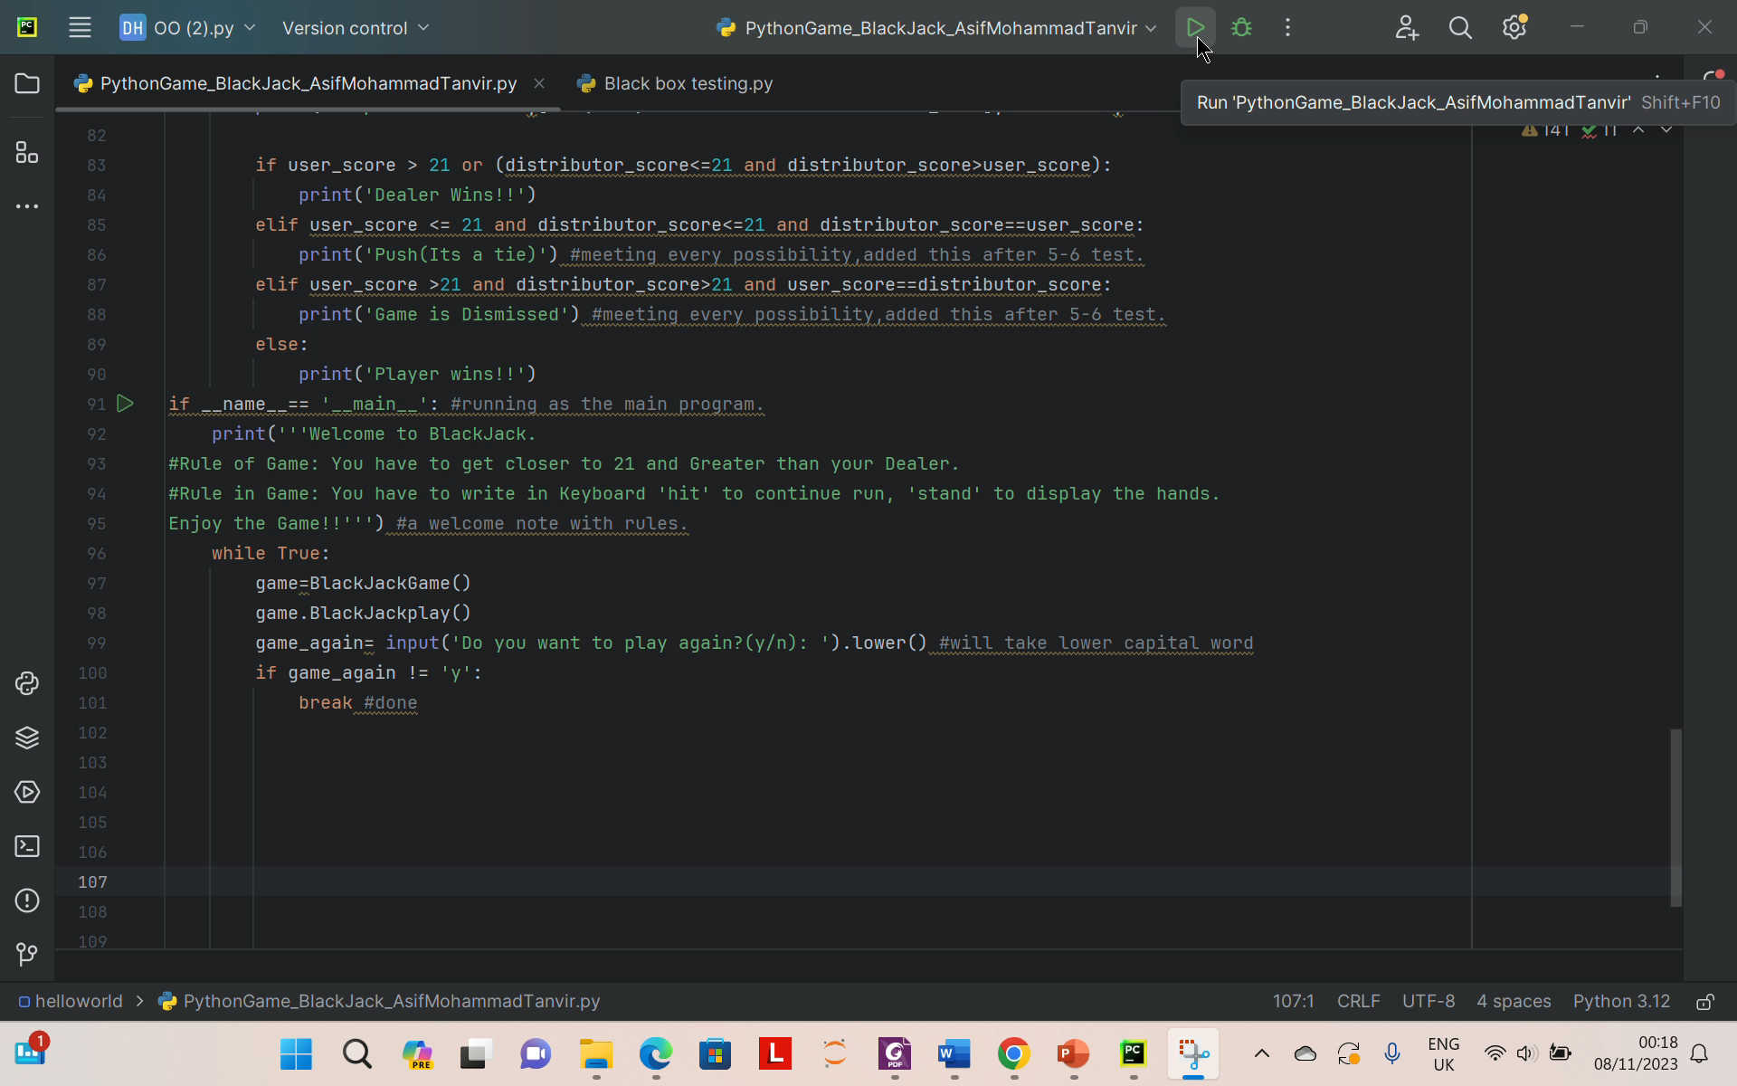

Slide 19

Black Box Testing:
Functional testing:
Functional testing is a technique that focuses on the desired functionality of a system without examining its internal workings. Although it is not considered a formal testing technique, it is often used to ensure that a system's specific requirements are met. In the case of a blackjack game, functional testing is an effective method for ensuring that the 'Score' function accurately calculates the total score, which is a critical requirement.

Slide 20
Black Box Testing:
import unittest #importing module for unit testing from PythonGame_BlackJack_AsifMohammadTanvir import BlackJackGame,BlackJackCard #from my main coding i have to import Game and card class Test_for_Calculation_score(unittest.TestCase): #class for testing def test_with_number_cards(self): #doing the test for number cards only hand=[BlackJackCard('Clubs','A' ),BlackJackCard('Diamond','A'), BlackJackCard('Hearts','10')] #taking two random cards game=BlackJackGame() score=game.Score(hand) self.assertEqual(score,12) #because 5 and 7 is equal to 12,assertEqual is method for comparing actual and expected score if __name__ =='__main__': unittest.main()

Slide 21
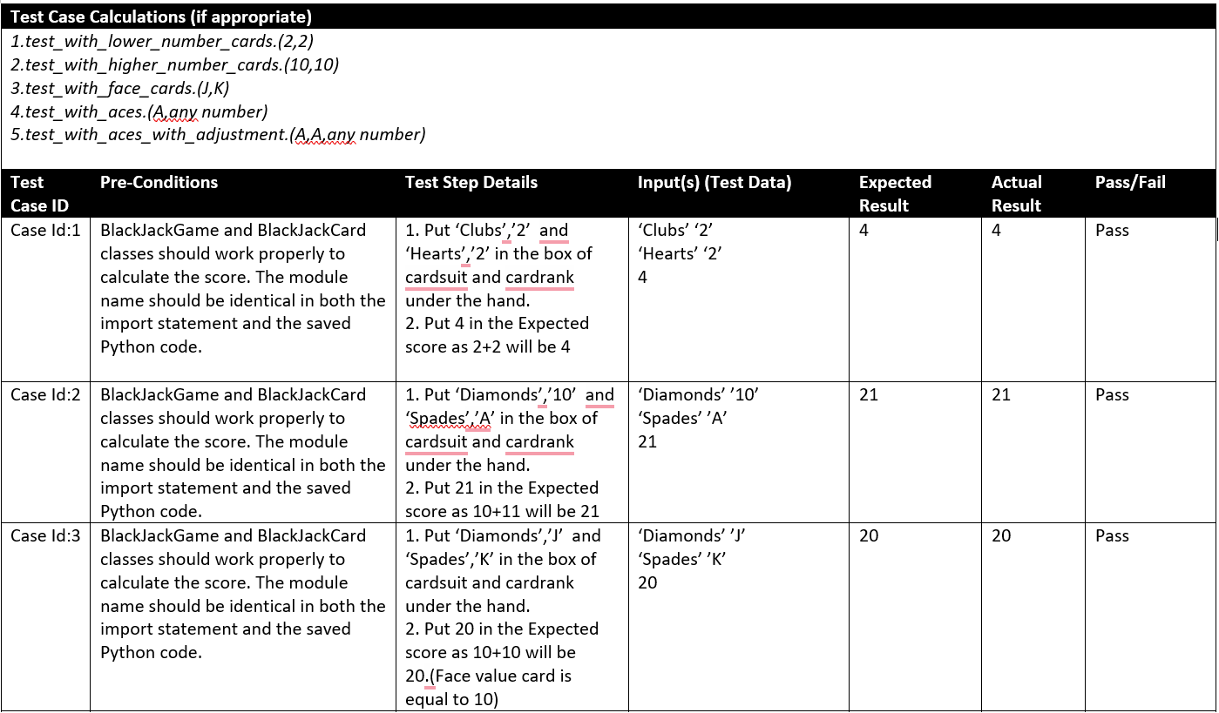
Black Box Testing:

Slide 22
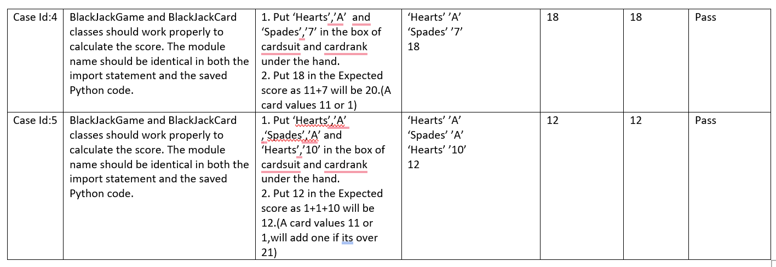
Black Box Testing:
I didn't take SBVA or RBVA because the game's objective doesn't involve value as directly as it does with the cards. So, I opted for the "Functionality Test" for black box testing. The primary determinant of winning or losing in this game is whether the program accurately calculates scores. However, some exceptional cases, such as ACES, are more prone to errors. For this reason, I chose this technique to identify any errors.

Slide 23
Which principle can I use out of four basic principle:
Inheritance: I can create a class for cards and then derive specific card types from it , such as blackjack cards.
Encapsulation:
In Python, there is no way to set the data private.
Polymorphism:
Function with many forms. It’s the ability to respond to different objects in the same method. There is a ‘play’ method in my code. If I use this method for blackjack or any other card games then I can use this term.
Abstraction:
Hiding the complex details and showing only necessary features. The common action is card game. I was using a deal, calculate score, and displaying hands in that class. I could keep it as a base class so I can abstract from it.
in

Slide 24

How I can tweak the GAME:
There are a few rules that can be changed in this game.
Firstly, the total number of cards needed to win can be altered. Currently, the total number of cards needed to win is 21, but I can make it 20 or 22 if needed.
Secondly, there is a rule for the dealer that they must draw cards automatically if their total card value is 17.
However, I can change this number to make the game more difficult.
Finally, this game can be played with either 3 or 4 players.

Slide 25
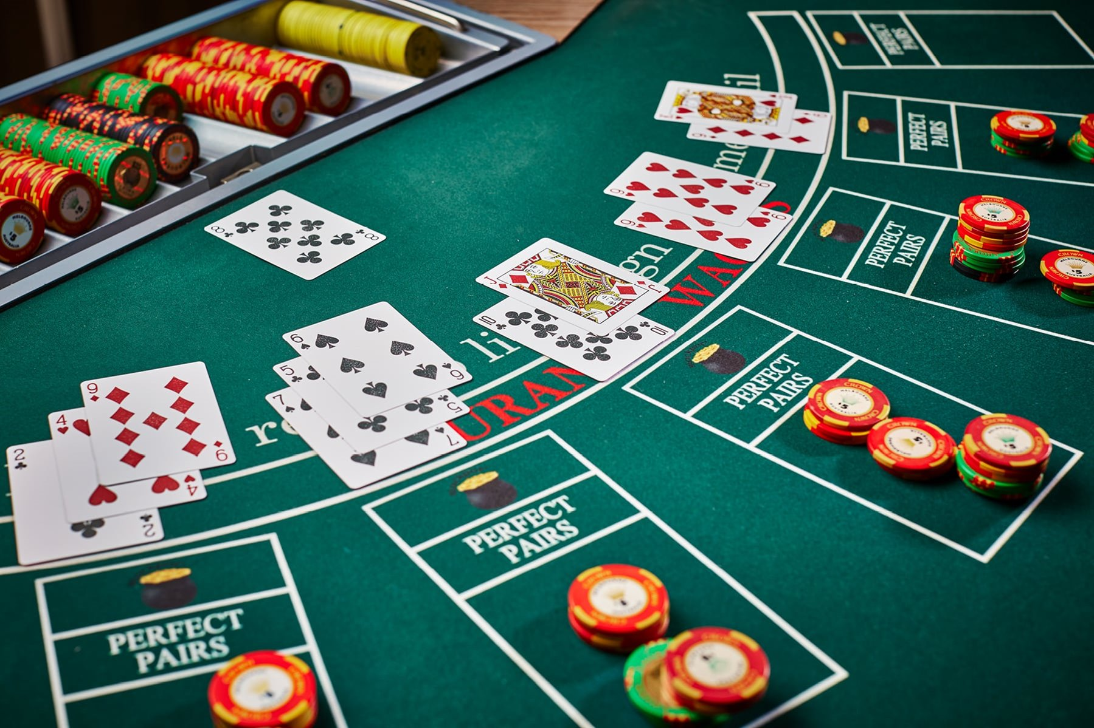
HOPE YOU ENJOY MY GAME ………..
Thank You

